Slide 1
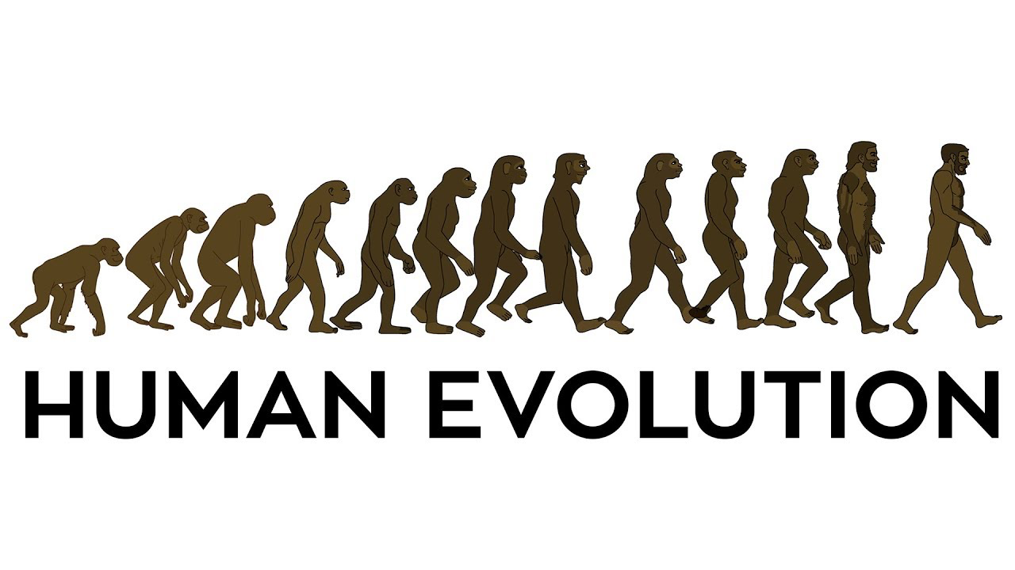
Human evolution

Slide 2
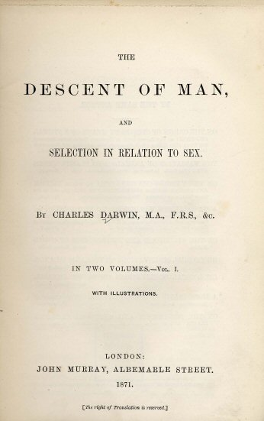
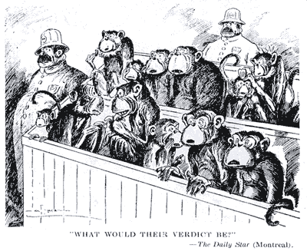
The descent of man
The reluctant Mr. Darwin
“During many years I collected notes on the origin or descent of man, without any intention of publishing in the subject, but rather with the determination not to publish, as I thought that I should thus only add to the prejudices against my views.”

Slide 3
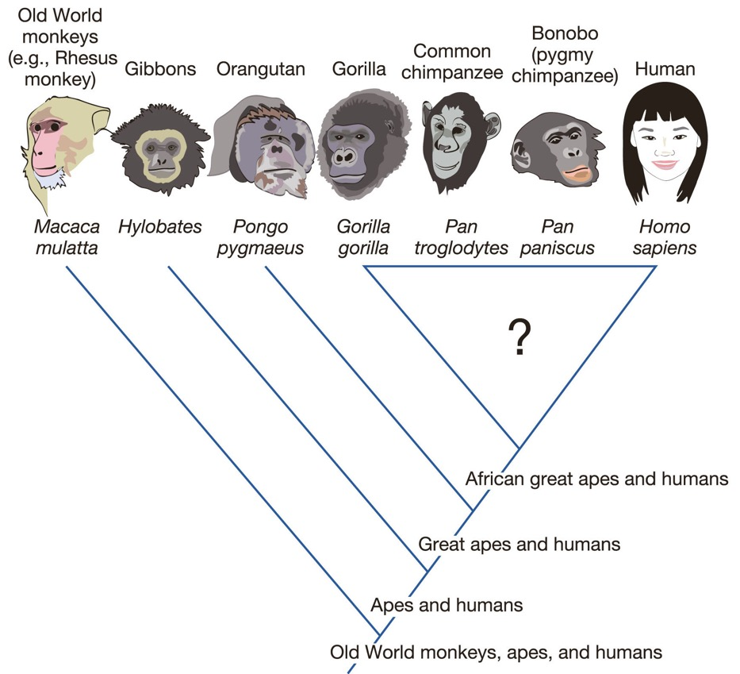
Human phylogenetic position
Early analyses could not resolve the relationships among the African great apes

Slide 4
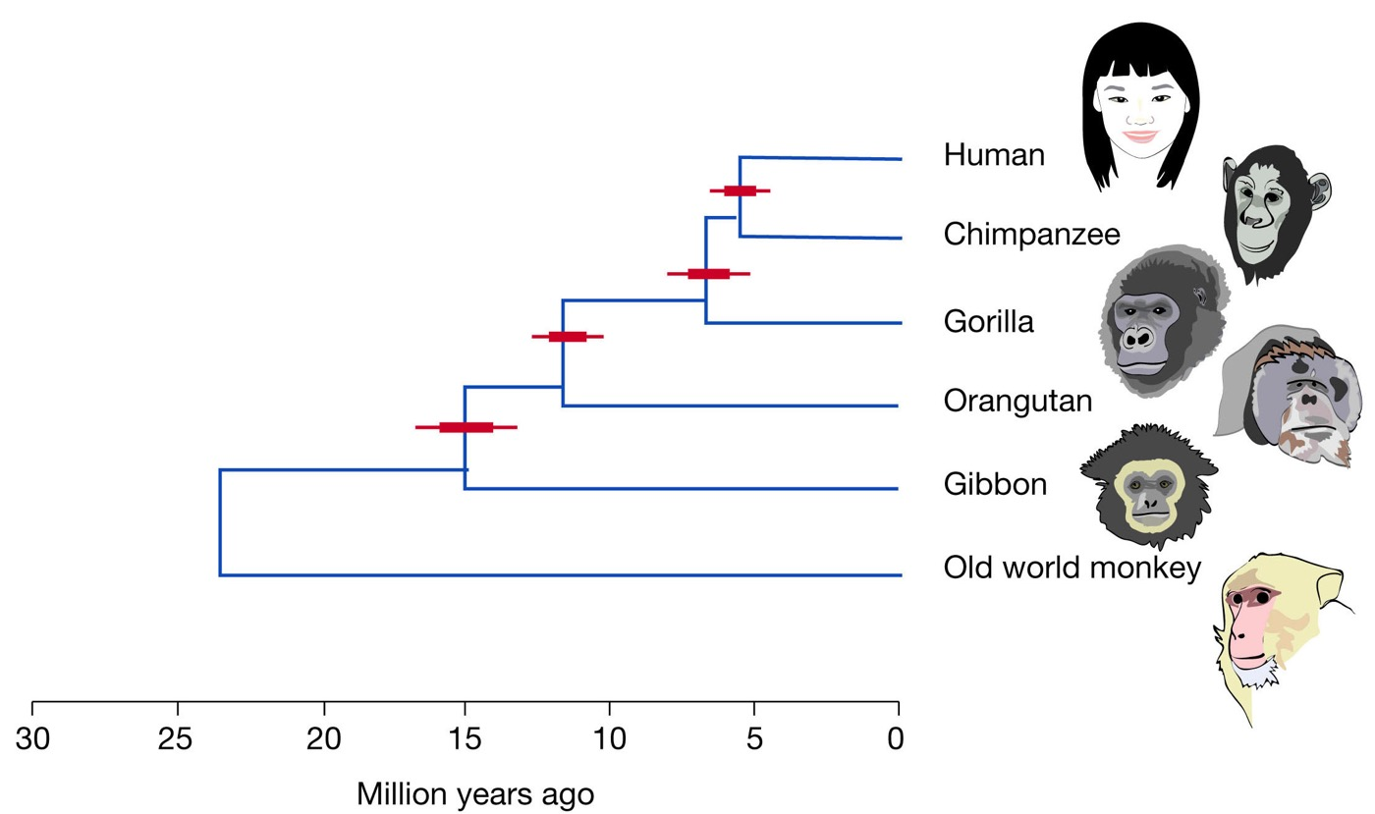
Human phylogenetic position
Early analyses could not resolve the relationships among the African great apes
Modern phylogenetic analyses indicate that humans are sister species to chimps
Molecular clock data suggests split between humans and chimps between 4.4 and 5.9 million years ago

Slide 5
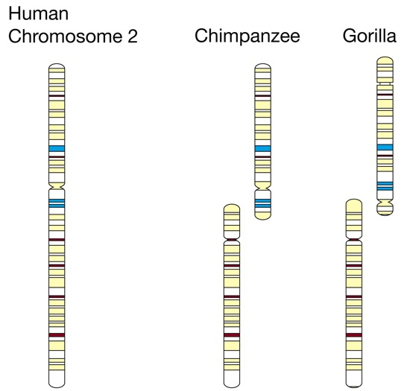
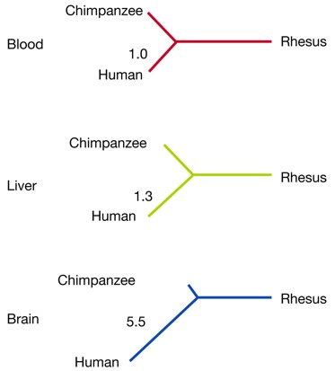
Genetic differences between humans and chimps
Chromosome numbers (chromosome fusion in human ancestor)
Human genome project allowed for quantification of sequence differences
Considering insertions and deletions, >95% of the genome is identical
Changes in gene expression are important in the expression of phenotypes
Gene expression:
Genetic divergence:
Sequence type | % difference
Noncoding intergenic | 1.24
Intronic | 0.93
Pseudogenes | 1.68
Coding sequences
Synonymous | 1.11
Nonsynonymous | 0.80

Slide 6
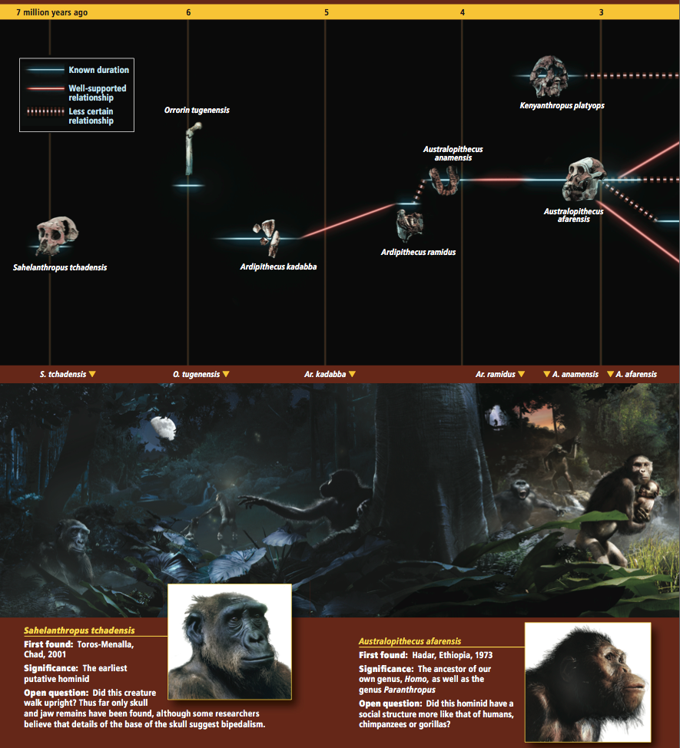
Fossil record
Sahelanthropus:
Fossil close to the shared ancestor of humans and chimps
Small brain, flat face
Early hominins:
Aridipithecus, Australopithecus, Kenyanthropus
Small, increasing brain size, bipedal
Australopithecus as a likely ancestor to various lineages (including Homo)

Slide 7
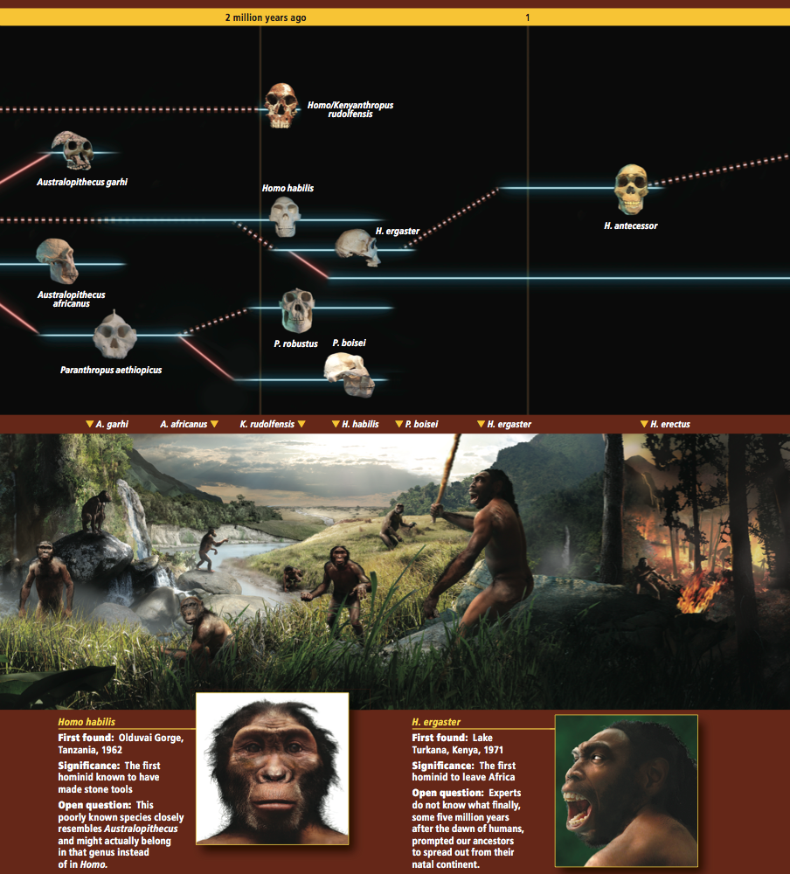
Fossil record
Paranthropus:
Small brain, large faces
Large cheek teeth, robust jaws, cranial rest
Adaptation to powerful chewing
Early Homo:
H. habilis & H. ergaster
Increase in brain size, flatter face
Body and tooth size similar to Australopithecus
Stone tools
First hominids to migrate out of Africa

Slide 8
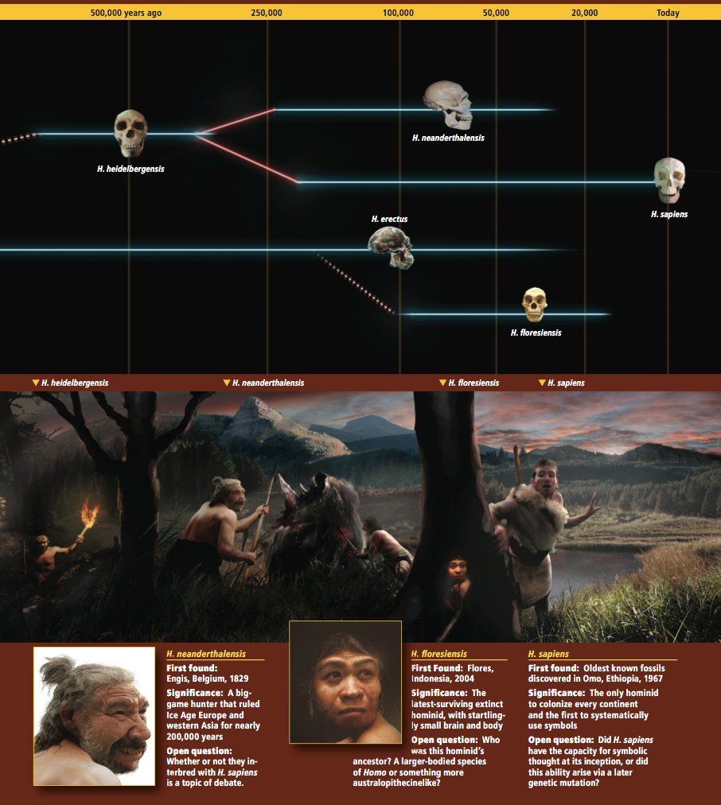
Fossil record
Modern Homo:
Very large brains, high steep foreheads
Two major lineages:
H. neanderthalensis & H. sapiens
H. erectus & H. florensis

Slide 9
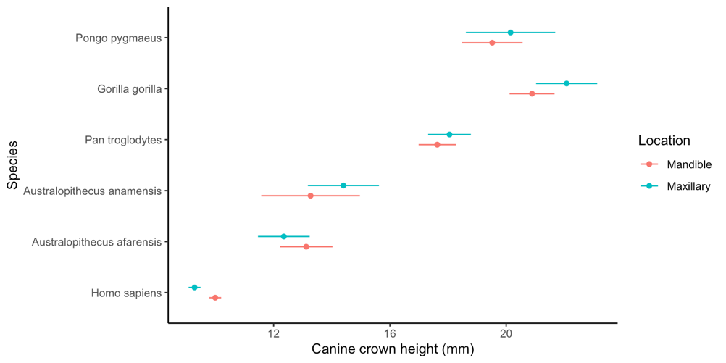
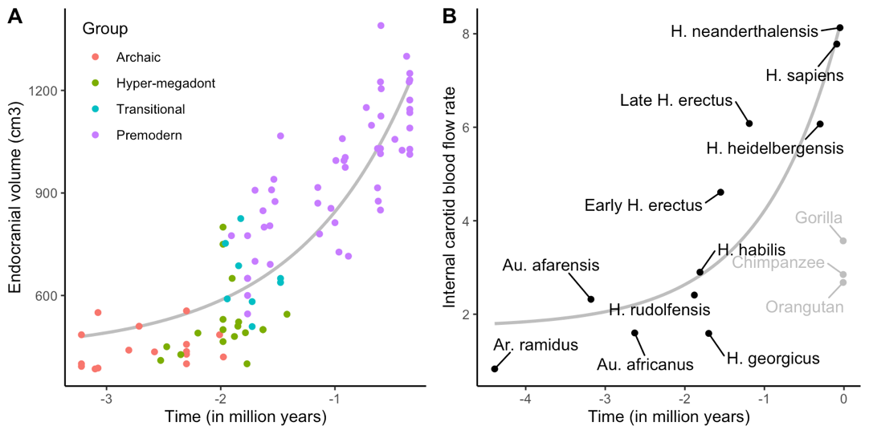
Evolutionary trends
Bipedalism
Non-honing chewing complex
Brain encephalization

Slide 10
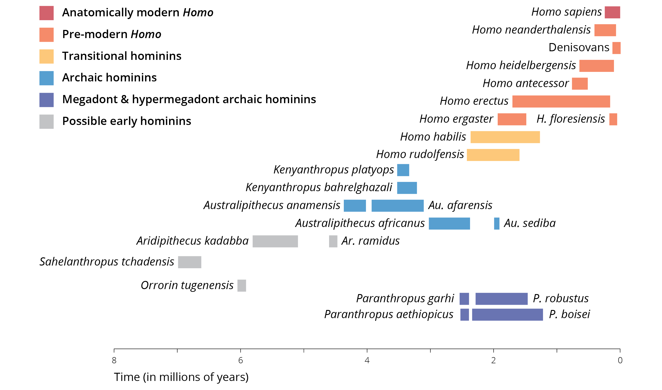
A radiation of hominids
Homo sapiens as the lone survivor of an extinct radiation of bipedal African hominids
Multiple species coexisted in Africa and other parts of the world
Relationship among fossil forms unresolved
How did modern humans emerge from among the others?

Slide 11
Modern human origins
What the fossils say:
Homo erectus fossils in Eurasia starting 1.8 mya
Homo sapiens fossils in Eurasia starting 200 kya
What hypotheses could explain the evolution of phenotypically diverse modern humans?

Slide 12
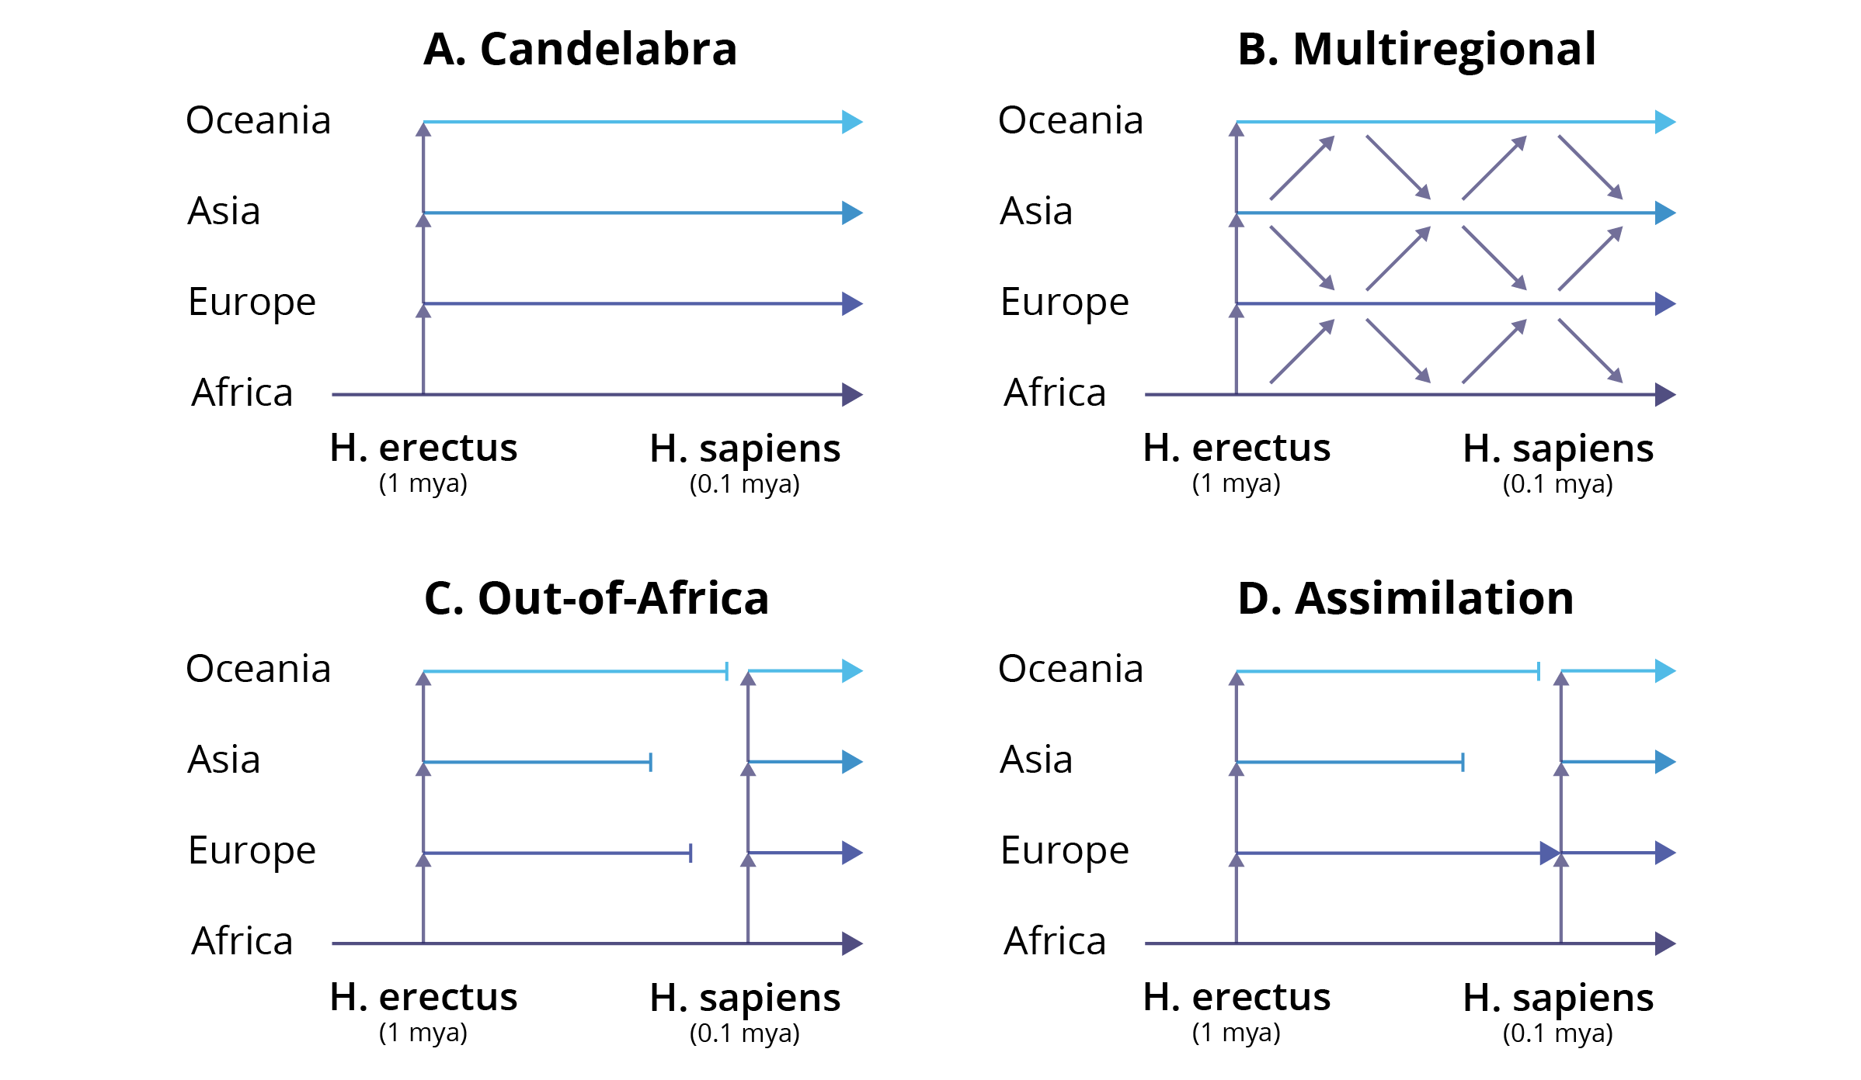
Modern human origins

Slide 13
Addressing hypotheses with data
The African replacement and multiregional evolution hypotheses make contrasting predictions
Criteria | African replacement | Multiregional evolution
1. Location of ancestral lineages | Mostly Africa | Random
2. Divergence time of African vs. non-African populations | 200,000 years or less | 1 million years or more
3. Genetic diversity | Genetic diversity greater in Africa | Genetic diversity equal in all regions
4. Sets of neutral alleles | Alleles present in Europe and Asia are subsets of those in Africa | Each regions has unique alleles, no region’s alleles are a subset of another regions

Slide 14
Discussion questions
In relation to the R exercise
How do data from paleontology and modern population genomics inform each other?
Why do you think there is only one surviving lineage from the diversity of humans that once existed?
Do you think humans are still evolving, and how does the future of evolution look like?
How do you think we can distinguish between the out-of-Africa and the hybridization and assimilation hypothesis? What data would you need? What are your predictions?

Slide 15
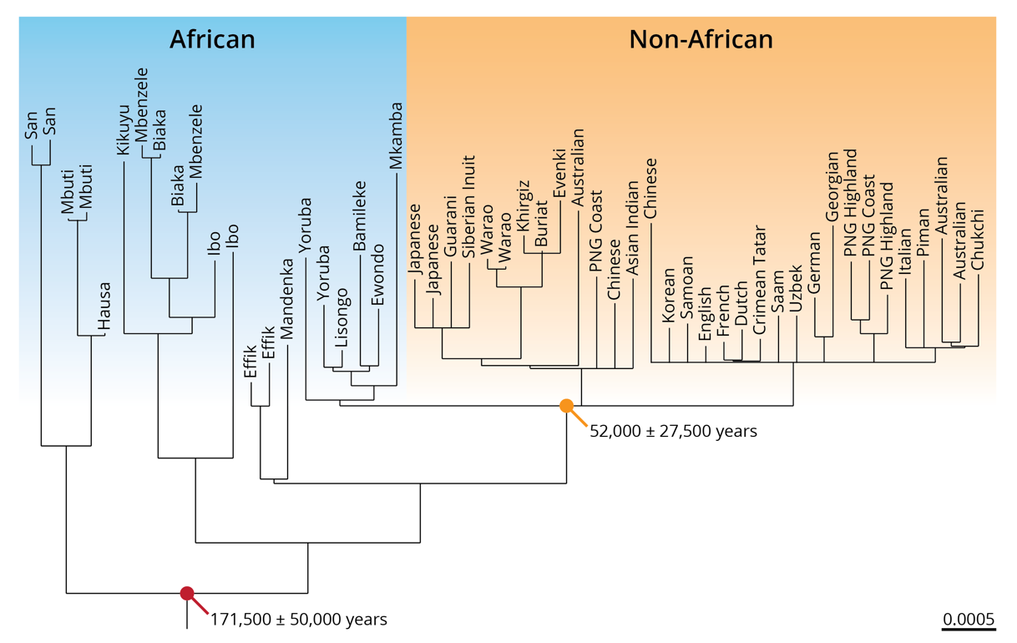
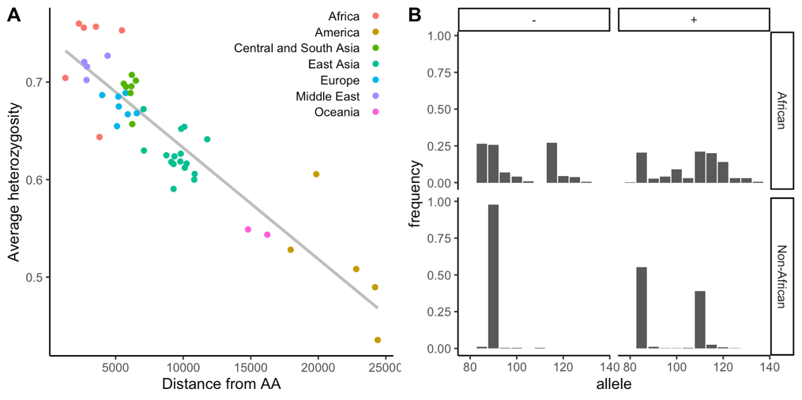
Addressing hypotheses with data
Modern humans evolved in Africa and replaced archaic humans elsewhere

Slide 16
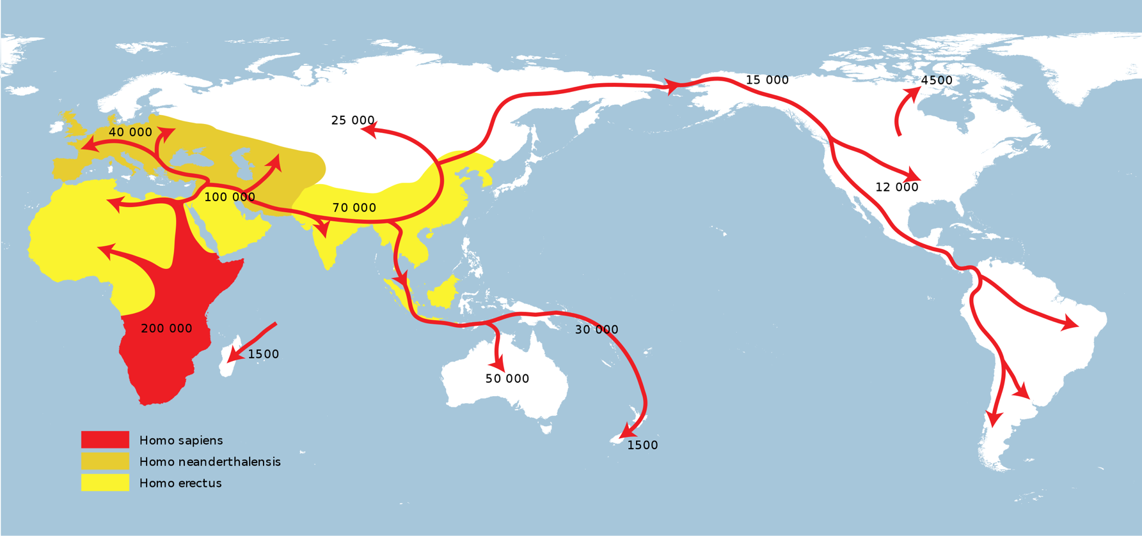
Addressing hypotheses with data
Modern humans evolved in Africa and replaced archaic humans elsewhere

Slide 17
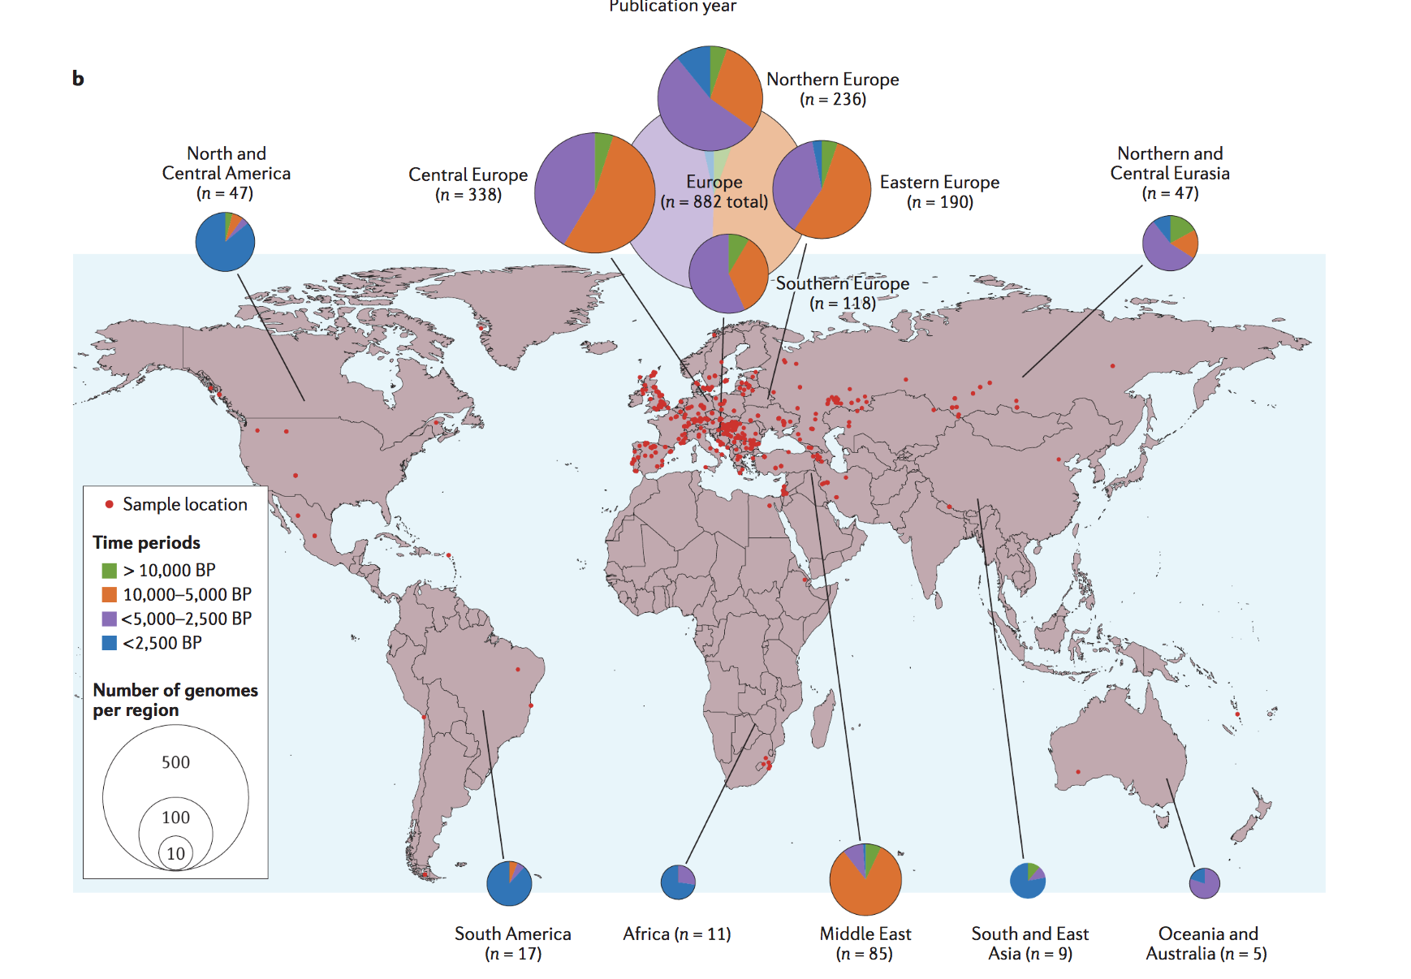
Ancient DNA and human origins

Slide 18
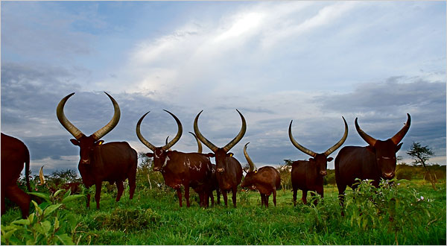
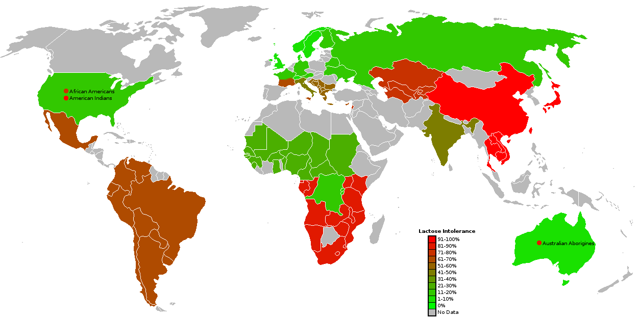
Evolution of lactose intolerance
Lactose intolerance: an evolutionary perspective
Lactase allows for digestion of milk sugar (lactose)
For most mammals, the only source of lactose is breast milk
Lactase production stops after weaning
In populations with a history of keeping domesticated cattle, individuals have a heritable ability to produce lactase as adults

Slide 19
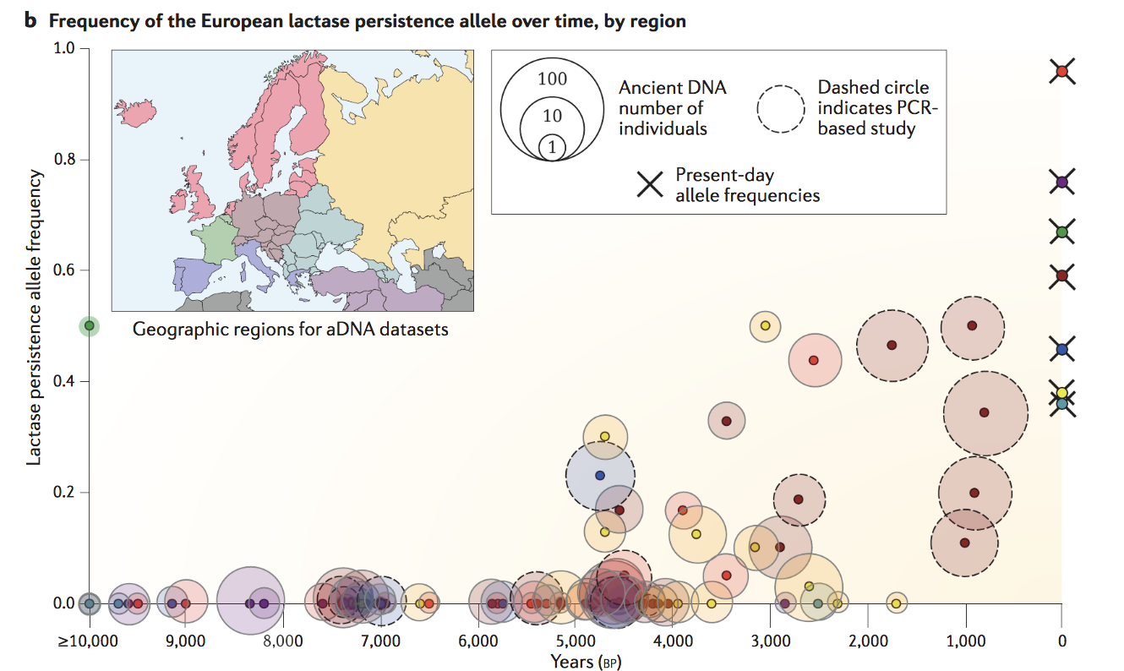
Evolution of lactose intolerance

Slide 20
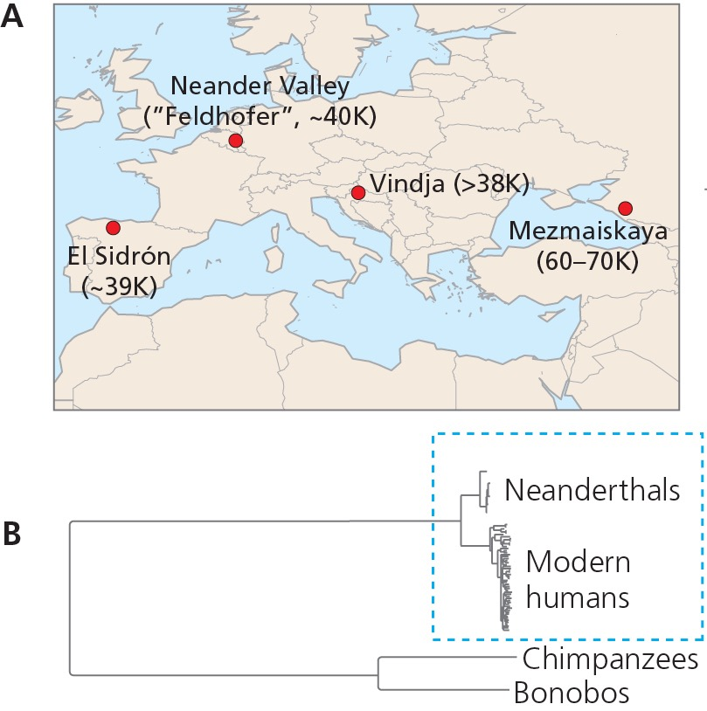
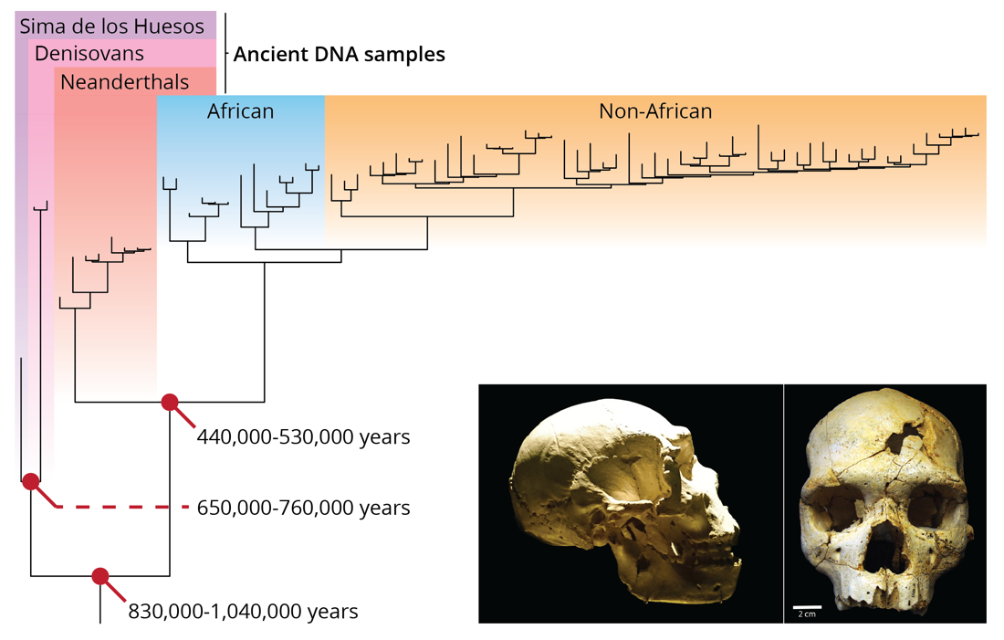
The phylogenetic position revisited

Slide 21
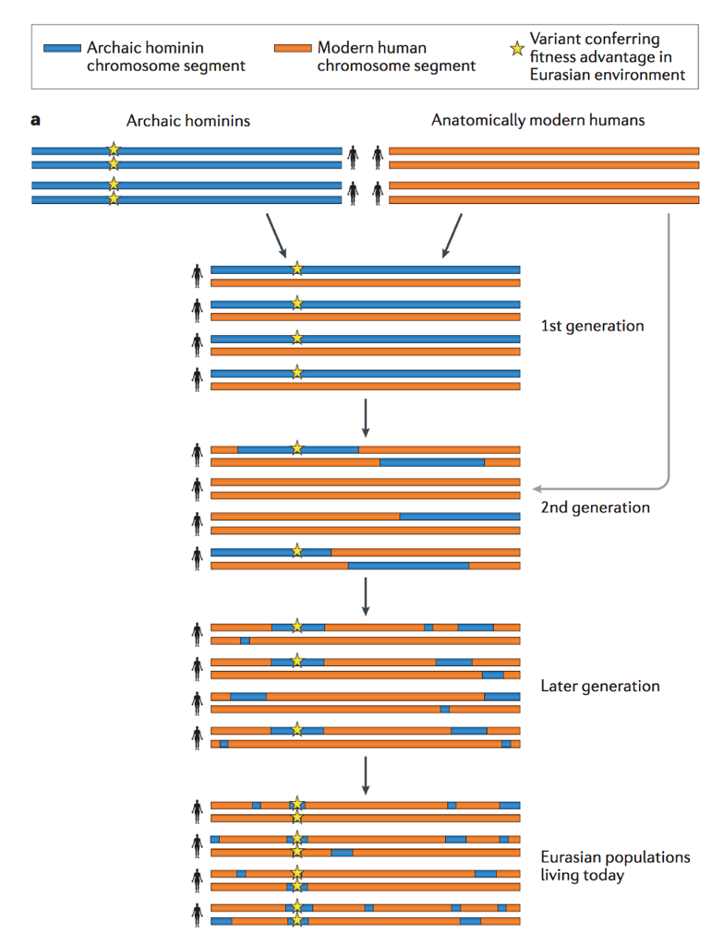
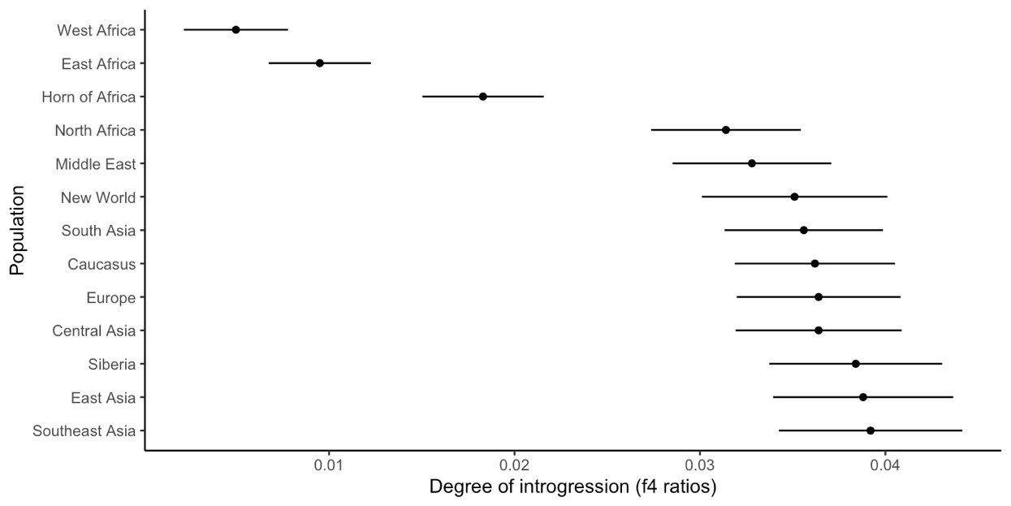
Evidence for hybridization and assimilation?
If hybridization occurred in prehistoric times, we expect to find sequences characteristic for ancient DNA in modern genomes in places where different human lineages coexisted and in portions of the genome that are relevant for adaptation

Slide 22
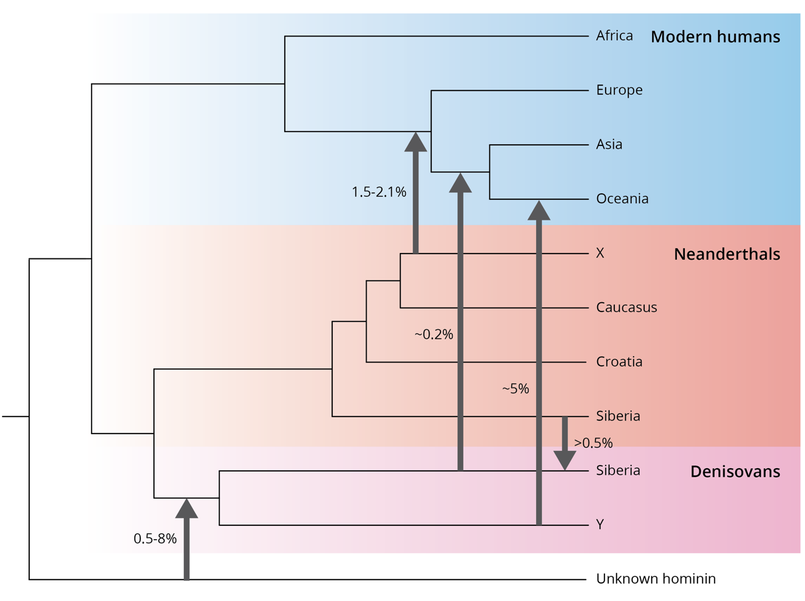
Evidence for hybridization and assimilation?
In 2010, the Neanderthal genome was sequenced based on the analysis of ancient DNA
Neanderthals share genes with European and Asian but not with African modern humans
Hybridization is now not only established between modern human lineages and Neanderthals, but also between modern humans and Denisovans, a genetically distinct lineage contemporary to Neanderthals.

Slide 23
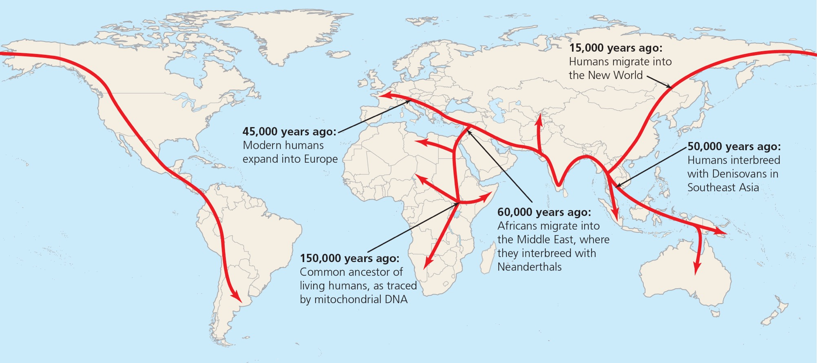
A revised history

Slide 24
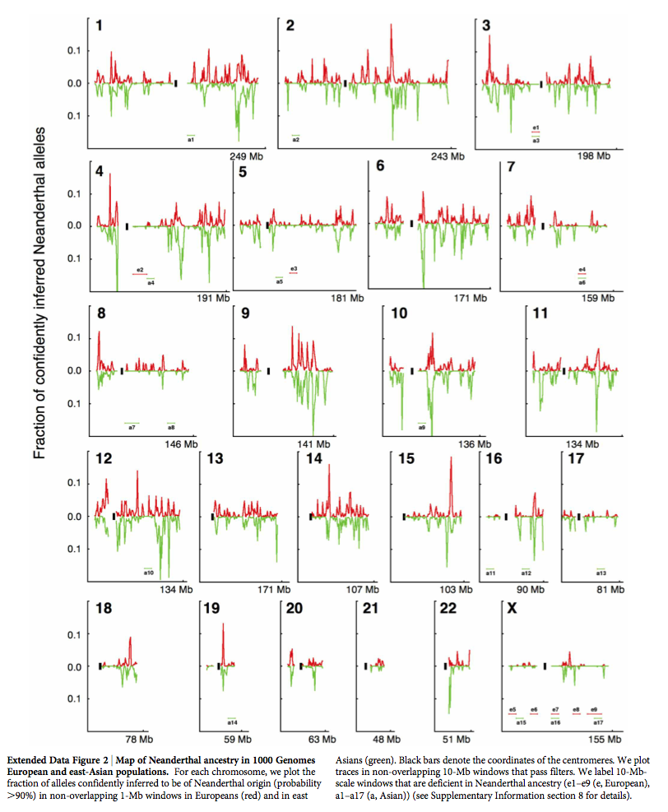
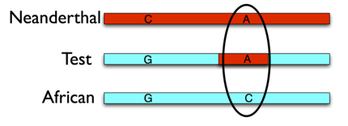
Comparative genomics
Introgression of genes associated with:
Formation of skin and hair
Coping with UV radiation
Immune responses

Slide 26
Logistics going forward
Dead week
Final assignments and revisions due on Dec 6 (let me know if that doesn’t work for you)
Normal discussion on Tuesday
Focus group/job day on Thursday
Self assessment due on Dec 10
TEVALs (pretty please)
Finals week
Ideally: NOTHING!
We are here to help people who need to finalize their work

Slide 27
The last blog post
How have your perceptions of evolution changed over the past months?
How have your perceptions of the process of science changed?
What do you feel have you really learned in this course; what are you taking away beyond the end of the semester?
What have you learned about your strengths and your areas in need of improvement?

